Slide 1
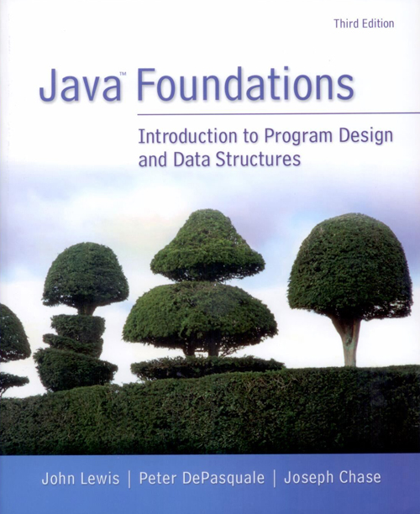
Chapter 25
Databases

Slide 2
Chapter Scope
Database concepts
Tables and queries
SQL statements
Managing data in a database

Slide 3
Databases
A database is a potentially large repository of data, organized for quick search and manipulation
A database management system (DBMS) is software that interacts with the database
Four primary operations: create, read, update, and delete (CRUD)
There are several underlying ways to organize a database
The most common type: a relational database

Slide 4
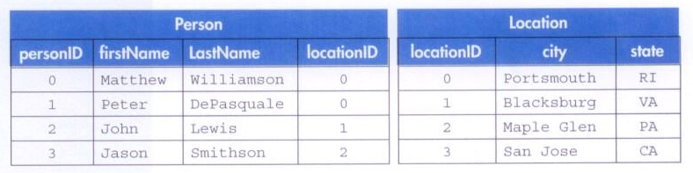
Database Tables
Two examples of database tables:

Slide 5
Database Tables
These tables are related using the locationID field
One location can be associated with multiple people without duplicating data
This saves space, reduces inconsistencies, and makes updates easier
We can query the database (ask it a question) to determine things like
How many people live in Maple Glen?

Slide 6
Database Connections
Before we can interact with a database in a Java program, we must first establish a connection
The Java Database Connectivity (JDBC) API provides software to establish the connection
In addition, we need software called a driver for the specific type of database used
For example, if you're using a MySQL databse, you'll need an appropriate MySQL driver
SQL (Structured Query Language) is a language for interacting with databases

Slide 7
import java.sql.*;
/**
* Demonstrates the establishment of a JDBC connector.
*
* @author Java Foundations
* @version 4.0
*/
public class DatabaseConnector
{
/**
* Establishes the connection to the database and prints an
* appropriate confirmation message.
*/
public static void main (String args[])
{
try
{
Connection conn = null;
// Loads the class object for the mysql driver into the DriverManager.
Class.forName("com.mysql.jdbc.Driver");

Slide 8
// Attempt to establish a connection to the specified database via the
// DriverManager
conn = DriverManager.getConnection("jdbc:mysql://comtor.org/" +
"javafoundations?user=jf2e&password=hirsch");
if (conn != null)
{
System.out.println("We have connected to our database!");
conn.close();
}
} catch (SQLException ex) {
System.out.println("SQLException: " + ex.getMessage());
ex.printStackTrace();
} catch (Exception ex) {
System.out.println("Exception: " + ex.getMessage());
ex.printStackTrace();
}
}
}

Slide 9
Creating Databases
A SQL statement called CREATE TABLE can be used to add a new table to the database
You specify the field names and sizes, among other things
CREATE TABLE Student (student_ID INT UNSIGNED NOT NULL AUTO_INCREMENT, PRIMARY KEY (student_ID), firstName varchar(255), lastName varchar(255))
This establishes that the student_ID field will be the primary key, which must be unique

Slide 10
Creating Databases
To execute this statement from a Java program, you store it as a string and invoke the execute method of the Statement class (from the JDBC)
String myCommand = "CREATE TABLE …";
Statement stmt = conn.createStatement();
boolean result = stmt.execute(myCommand);

Slide 11
Altering Tables
The structure of a database table can be changed with the ALTER TABLE statement
To add age and gpa fields to the Student table:
ALTER TABLE Student ADD COLUMN (age tinyint UNSIGNED, gpa FLOAT (3,2) unsigned)
To eliminate a field and remove all of its data:
ALTER TABLE Student DROP COLUMN firstName

Slide 12
Queries
Data from a query is returned in a ResultSet object
The SHOW COLUMNS statement returns the structure (a list of fields and their attributes) of a table
ResultSet rSet = stmt.executeQuery("SHOW COLUMNS FROM Student");
We can extract meta data from the result set:
ResultSetMetaData rsmd = rSet.getMetaData();
int numColumns = rsmd.getColumnCount();

Slide 13
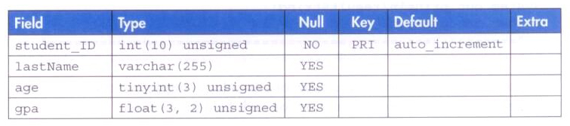
Queries
The metadata for the Student table:

Slide 14
Inserting Data
The INSERT command is used to add a row of data to a table
It specifies the columns and their corresponding values:
INSERT Student (lastName, age, gpa) VALUES ("Campbell", 19, 3.79)
The studentID field is automatically incremented, and therefore not specified

Slide 15
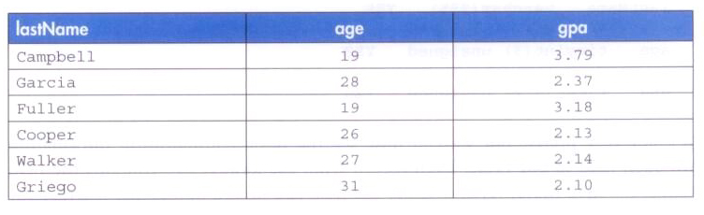
Inserting Data
Some sample data for the Student class:

Slide 16
Retrieving Data
The SELECT … FROM command is used to retrieve specific data from the database
To get a list of all student's names and GPAs:
SELECT lastName, gpa FROM Student
A * can be used to get all fields
The WHERE clause further specifies which data is sought:
SELECT * FROM Student WHERE age >= 21 && gpa <= 3.0

Slide 17
Updating Data
To update existing data in a table, we:
Obtain a ResultSet and navigate to the row(s) to update
Update the ResultSet value(s)
Update the database with the revised ResultSet
ResultSet rSet = stmt.executeQuery("SELECT * FROM Student WHERE lastName = \"Jones\"");
rSet.first()
rSet.updateFloat("gpa", 3.41f);
rSet.UpdateRow();

Slide 18
import java.sql.*;
/**
* Demonstrates interaction between a Java program and a database.
*
* @author Java Foundations
* @version 4.0
*/
public class DatabaseModification
{
/**
* Carries out various CRUD operations after establishing the
* database connection.
*/
public static void main (String args[])
{
Connection conn = null;
try
{
// Loads the class object for the mysql driver into the DriverManager.
Class.forName("com.mysql.jdbc.Driver");
// Attempt to establish a connection to the specified database via the
// DriverManager
conn = DriverManager.getConnection("jdbc:mysql://comtor.org/" +
"javafoundations?user=jf2e&password=hirsch");

Slide 19
// Check the connection
if (conn != null)
{
System.out.println("We have connected to our database!");
// Create the table and show the table structure
Statement stmt = conn.createStatement();
boolean result = stmt.execute("CREATE TABLE Student " +
" (student_ID INT UNSIGNED NOT NULL AUTO_INCREMENT, " +
" PRIMARY KEY (student_ID), lastName varchar(255), " +
" age tinyint UNSIGNED, gpa FLOAT (3,2) unsigned)");
System.out.println("\tTable creation result: " + result);
DatabaseModification.showColumns(conn);
// Insert the data into the database and show the values in the table
Statement stmt2 = conn.createStatement(ResultSet.TYPE_FORWARD_ONLY,
ResultSet.CONCUR_UPDATABLE);
int rowCount = stmt2.executeUpdate("INSERT Student " +
"(lastName, age, gpa) VALUES (\"Campbell\", 19, 3.79)");
DatabaseModification.showValues(conn);
// Close the database
conn.close();
}

Slide 20
} catch (SQLException ex) {
System.out.println("SQLException: " + ex.getMessage());
ex.printStackTrace();
} catch (Exception ex) {
System.out.println("Exception: " + ex.getMessage());
ex.printStackTrace();
}
}
/**
* Obtains and displays a ResultSet from the Student table.
*/
public static void showValues(Connection conn)
{
try
{
Statement stmt = conn.createStatement();
ResultSet rset = stmt.executeQuery("SELECT * FROM Student");
DatabaseModification.showResults("Student", rset);
} catch (SQLException ex) {
System.out.println("SQLException: " + ex.getMessage());
ex.printStackTrace();
}
}

Slide 21
/**
* Displays the structure of the Student table.
*/
public static void showColumns(Connection conn)
{
try
{
Statement stmt = conn.createStatement();
ResultSet rset = stmt.executeQuery("SHOW COLUMNS FROM Student");
DatabaseModification.showResults("Student", rset);
} catch (SQLException ex) {
System.out.println("SQLException: " + ex.getMessage());
ex.printStackTrace();
}
}

Slide 22
/**
* Displays the contents of the specified ResultSet.
*/
public static void showResults(String tableName, ResultSet rSet)
{
try
{
ResultSetMetaData rsmd = rSet.getMetaData();
int numColumns = rsmd.getColumnCount();
String resultString = null;
if (numColumns > 0)
{
resultString = "\nTable: " + tableName + "\n" +
"=======================================================\n";
for (int colNum = 1; colNum <= numColumns; colNum++)
resultString += rsmd.getColumnLabel(colNum) + " ";
}
System.out.println(resultString);
System.out.println(
"=======================================================");

Slide 23
while (rSet.next())
{
resultString = "";
for (int colNum = 1; colNum <= numColumns; colNum++)
{
String column = rSet.getString(colNum);
if (column != null)
resultString += column + " ";
}
System.out.println(resultString + '\n' +
"-------------------------------------------------------");
}
} catch (SQLException ex) {
System.out.println("SQLException: " + ex.getMessage());
ex.printStackTrace();
}
}
}

Slide 24
Deleting Data
To delete specific data from a table:
DELETE FROM Student WHERE age >= 30
To delete an entire table:
DROP TABLE Student

